Slide 1
XML Schema
Notes:
https://www.youtube.com/watch?v=56pR_5rO-m4
SGML stands for Standard Generalized Markup Language
For our purposes, a DTD, or Document Type Definition, is simply a file that defines the syntax of a SGML-based language.
https://www.youtube.com/watch?v=o295c89kotU
https://www.youtube.com/watch?v=f8f-v5-PvVs //Important
https://www.youtube.com/watch?v=xIAhnDE-fzU

Slide 2
Introduction
It is used to represent the structure of xml document.
The goal of xml schema is to define the building block of an xml document.
It can be used as an alternative to XML DTD.
XML Schema is commonly known as XML Schema Definition (XSD).
It defines elements, attributes, data types, elements having child elements, order of child element.
It also defines fixed and default values of elements and attributes.
It is used to describe and validate the structure and the content of XML data.
Notes:
https://www.youtube.com/watch?v=optvmhDo8E0
https://www.youtube.com/watch?v=vIW1XcsakV0
https://www.youtube.com/watch?v=1EBWzbO8lgs
https://www.youtube.com/watch?v=TxqrCBJVJhg

Slide 3
XSD - The <schema> Element
The <schema> element is the root element of every XML Schema.
<?xml version="1.0"?> <xs:schema> ... ... </xs:schema>

Slide 4
Example
<?xml version = "1.0" encoding = "UTF-8"?>
<xs:schema xmlns:xs = "http://www.w3.org/2001/XMLSchema">
<xs:element name = "contact">
<xs:complexType>
<xs:sequence>
<xs:element name = "name" type = "xs:string" />
<xs:element name = "company" type = "xs:string" />
<xs:element name = "phone" type = "xs:int" />
</xs:sequence>
</xs:complexType>
</xs:element>
</xs:schema>

Slide 5
Xs : Identify schema elements and type
Xs:schema -> document element of schema
Attribute xmlns:xs -> which has value http://www.w3.org/2001/XMLSchema
This declaration indicate that document should follow the rules of XML schema
Xs:element ->used to define the xml element
Xs:sequence-> indicate that while defining element, must use in same sequence
Type:string -> all element have different datatype

Slide 6
<?xml version=“1.0” ?>
<student xmlns:xsi=http://www.w3.org/2001/XMLSchema-instance
Xsi=schemaLocation=“name.xsd”
>
<name>xyz</name>
</student>

Slide 7
Xmlns:xsi -> attribute of doc which indicates that xml document is an instance of xml schema
Xsi=schemaLocation-> to tie xml doc with some schema definition
The value passed in this attribute is name of xsd file.

Slide 8
XML Schema Instance Attributes
The XML Schema definition language (XSD) defines four attributes for use in XML instance documents.
These attributes are in the http://www.w3.org/2001/XMLSchema-instance namespace.
These attributes are often prefixed with xsi, although any prefix can be used and mapped to the http://www.w3.org/2001/XMLSchema-instance namespace URI.

Slide 9
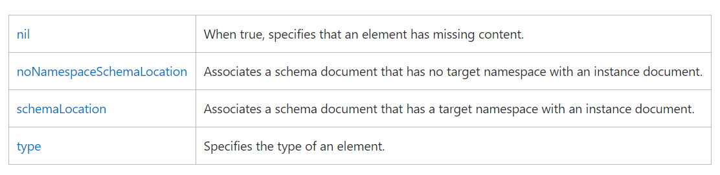
The following table describes the XML Schema instance attributes.
Notes:
https://msdn.microsoft.com/en-us/library/ms256142(v=vs.110).aspx

Slide 10
The <schema> element may contain some attributes.
<?xml version="1.0"?> <xs:schema xmlns:xs="http://www.w3.org/2001/XMLSchema" targetNamespace="https://localhost/xml-xsd" xmlns="https://www.w3schools.com" elementFormDefault="qualified"> ... ... </xs:schema>

Slide 11
XSD Simple Elements
XML Schemas define the elements of your XML files.
A simple element is an XML element that contains only text.
It cannot contain any other elements or attributes.
However, the "only text" restriction is quite misleading.
The text can be of many different types.
It can be one of the types included in the XML Schema definition (boolean, string, date, etc.), or it can be a custom type that you can define yourself.
You can also add restrictions (facets) to a data type in order to limit its content, or you can require the data to match a specific pattern.

Slide 12
Defining a Simple Element
<xs:element name="xxx" type="yyy"/>
XML Schema has a lot of built-in data types.
xs:string
xs:decimal
xs:integer
xs:boolean
xs:date
xs:time

Slide 13
Example
<xs:element name="lastname" type="xs:string"/> <xs:element name="age" type="xs:integer"/> <xs:element name="dateborn" type="xs:date"/>

Slide 14
Default and Fixed Values for Simple Elements
Simple elements may have a default value OR a fixed value specified.
A default value is automatically assigned to the element when no other value is specified.
In the following example the default value is "red":
<xs:element name="color" type="xs:string" default="red"/>
A fixed value is also automatically assigned to the element, and you cannot specify another value.
In the following example the fixed value is "red":
<xs:element name="color" type="xs:string" fixed="red"/>

Slide 15
XSD Attributes
All attributes are declared as simple types.
Simple elements cannot have attributes.
If an element has attributes, it is considered to be of a complex type.
But the attribute itself is always declared as a simple type.
Syntax:
<xs:attribute name="xxx" type="yyy"/>

Slide 16
Built-In Data Type
xs:string
xs:decimal
xs:integer
xs:boolean
xs:date
xs:time
E.g.
<lastname lang="EN">Smith</lastname> // XML
<xs:attribute name="lang" type="xs:string"/> //Schema

Slide 17
Default and Fixed Values for Attributes
Attributes may have a default value OR a fixed value specified.
A default value is automatically assigned to the attribute when no other value is specified.
E.g.
<xs:attribute name="lang" type="xs:string" default="EN"/>
<xs:attribute name="lang" type="xs:string" fixed="EN"/>

Slide 18
Optional and Required Attributes
Attributes are optional by default. To specify that the attribute is required, use the "use" attribute:
<xs:attribute name="lang" type="xs:string" use="required"/>

Slide 19
Restrictions on Content
When an XML element or attribute has a data type defined, it puts restrictions on the element's or attribute's content.
If an XML element is of type "xs:date" and contains a string like "Hello World", the element will not validate.
With XML Schemas, you can also add your own restrictions to your XML elements and attributes.
These restrictions are called facets. You can read more about facets in the next chapter.

Slide 20
Complex Types
It is the element that contain some other elements and attributes.
It Includes:
Empty Type
Elements that contain text
Elements that contain other element
Element that contain text as well as other element.

Slide 21
Indicators
It allow us to define the elements in the manner we want
All
Choice
Sequence
Maxoccurs
Minoccurs

Slide 22
All indicator
Specify that all the child elements must occur in any sequence but each child must appear at least once.
Sequence
For specifying that the child elements must be present in some order.

Slide 23
Choice indicator
Using this, we can select the element of our own choice.
For this, it is not necessary to have all the elements present in XML document.

Slide 24
maxOccurs
It is used to denote the maximum number of times an element can occur.
minOccurs
It is used to denote the minimum number of times an element can occur.

Slide 25
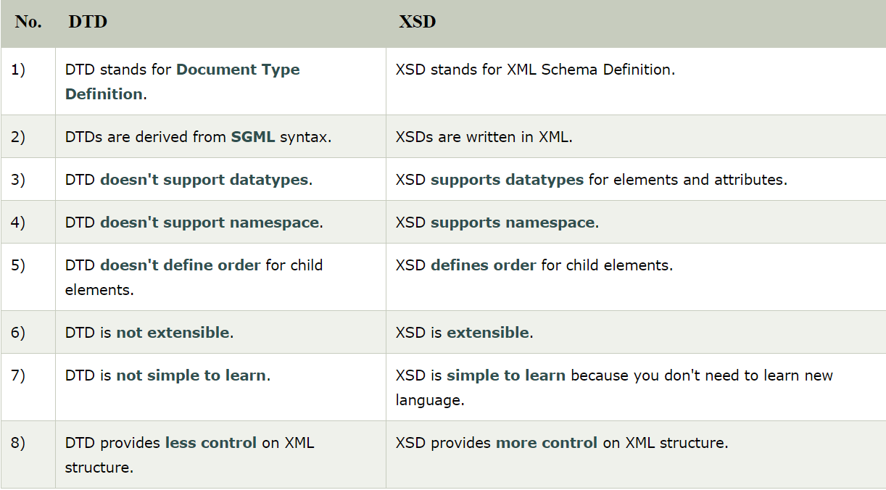
Notes:
SGML: Standard Generalized Markup Language
SGML is based on the idea that documents have structural and other semantic elements that can be described without reference to how such elements should be displayed.
SGML (Standard Generalized Markup Language) is a standard for how to specify a document markup language or tag set. Such a specification is itself a document type definition (DTD).SGML is not in itself a document language, but a description of how to specify one.

Slide 26
XML Schemas are More Powerful than DTD
XML Schemas are written in XML
XML Schemas are extensible to additions
XML Schemas support data types
XML Schemas support namespaces

Slide 27
XML Schemas Support Data Types
It is easier to describe allowable document content
It is easier to validate the correctness of data
It is easier to define data facets (restrictions on data)
It is easier to define data patterns (data formats)
It is easier to convert data between different data types

Slide 28
XML Schemas use XML Syntax
You don't have to learn a new language
You can use your XML editor to edit your Schema files
You can use your XML parser to parse your Schema files
You can manipulate your Schemas with the XML DOM
You can transform your Schemas with XSLT

